Slide 1
.Net MAUI Styles

Slide 2
Content
What are Styles and what are they used for?
Style Hierarches:
App, Page, Control / View level.
Explicit, Implicit
Dynamic Styles
Demo (https://github.com/oferzad/MauiStylesDemo.git)
Right To Left Applications (https://github.com/oferzad/MauiRTLDemo.git)
Form Validation

Slide 3
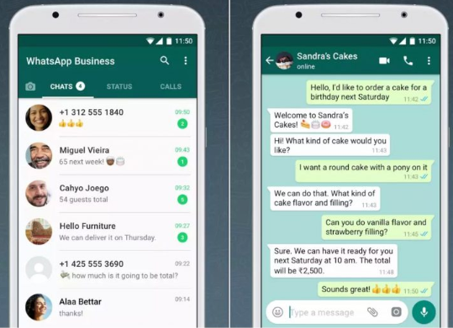
What Are Styles and Why do we need it?
Styles are groups of all settings that dictates the look and feel of the application, a specific page or specific view!
To maintain an easy to use UI and good user experience it is required to maintain the same styles through out the entire application (Same fonts, colors, etc…)
Up until now, we set the style for each individual view object by setting its style properties. To ensure the same styles for the entire app, we had to retype the same property values for each and every View. With Styles – we can set it up once and reference the style name in each of the views!

Slide 4
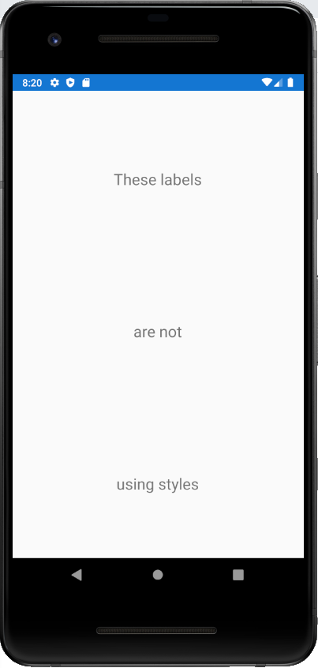
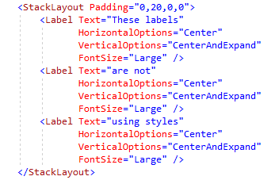
No Style

Slide 5
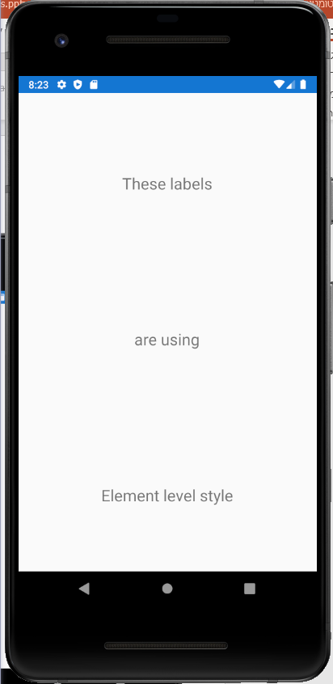
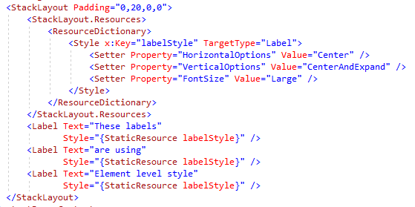
Element Level Explicit Style

Slide 6
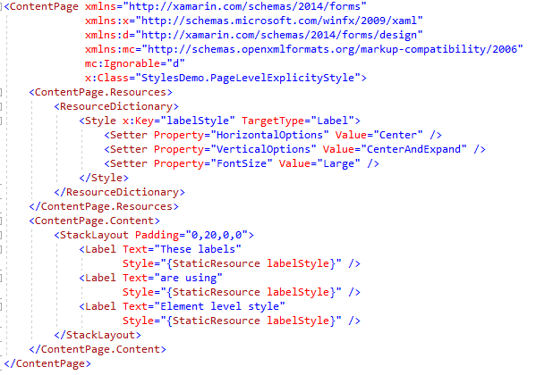
Page Level Explicit Style

Slide 7
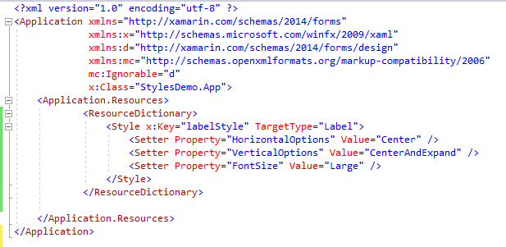
App Level Explicit Style

Slide 8
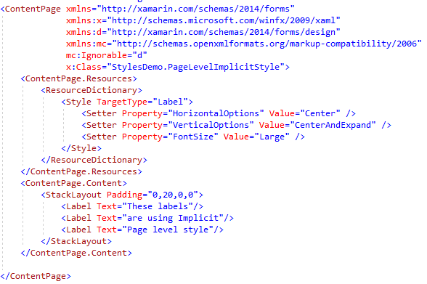
Implicit Styles (Can be declared in all levels)

Slide 9
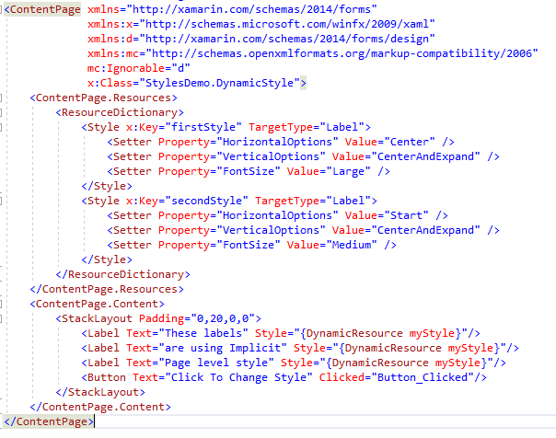
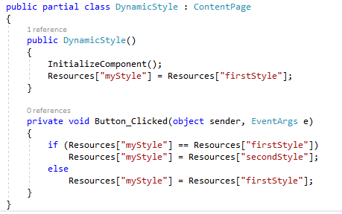
Dynamic Styles

Slide 10
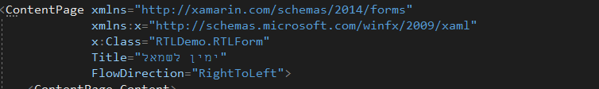
Right to Left
If we want to create a Hebrew UI we should let the Xamarin render the Xamarin tags from right to left rather than left to right!
It can easily done by making the following changes:
In the Content Page tag a Flow Direction should be set as follows:
To support both English and Hebrew, a localization should be defined. To learn more visit the following link (Localization - .NET MAUI | Microsoft Learn)

Slide 11
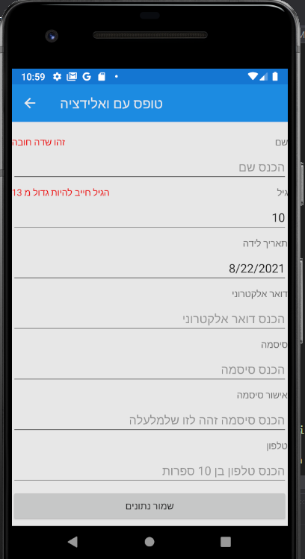
Form Validation (A must for the project!)
When data is entered to the application the application MUST check that the data is correct and valid! The application should avoid sending bad information to the server and should give the user guidance when such data is entered!
The demo shows a possible implementation for data validation although it can be implemented in different ways.

Slide 12
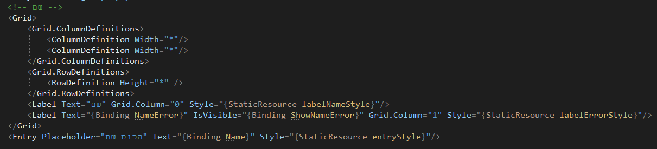
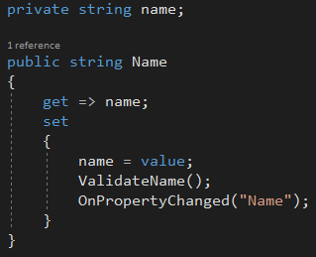
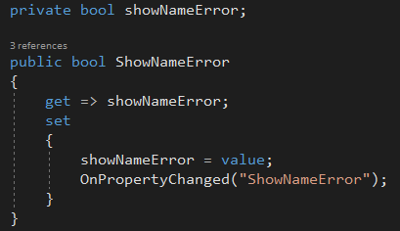
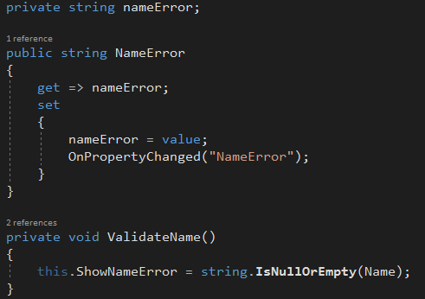
Form Field Validation Implementation
In the View XAML and and corresponding View Model class

Slide 13
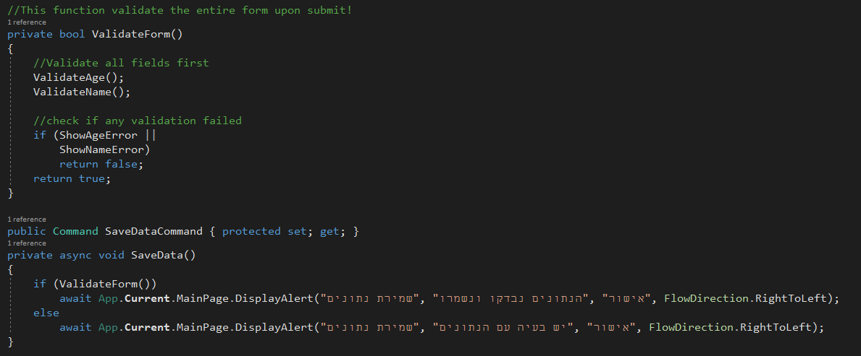
Full Form Validation Implementation
In the View XAML and and corresponding View Model class

Slide 14
Exercise
Change the Form Validation example so validation will apply to Birth Date (should reflect age of at least 13 years), and password approval (must be exactly like the password)
Use Implicit App level styles to define all buttons to be green.
Use explicit app level styles to define the submit form button text size to be 24

